Slide 1
Ethereum: mechanics
Dr. Risman Adnan

Slide 2
Limitations of Bitcoin
Recall: UTXO contains (hash of) ScriptPK
simple script: indicates conditions when UTXO can be spent
Limitations:
Difficult to maintain state in multi-stage contracts
Difficult to enforce global rules on assets
A simple example: rate limiting. My wallet manages 100 UTXOs.
Desired policy: can only transfer 2BTC per day out of my wallet
Notes:
a UTXO being spent cannot tell how many of my other UTXOs were spent during that day.

Slide 3
An example: NameCoin
Domain name system on the blockchain: [google.com ⇾ IP addr]
Need support for three operations:
Name.new(OwnerAddr, DomainName): intent to register
Name.update(DomainName, newVal, newOwner, OwnerSig)
Name.lookup(DomainName)
Note: also need to ensure no front-running on Name.new()

Slide 4
A broken implementation
Name.new() and Name.upate() create a UTXO with ScriptPK:
DUP HASH256 <OwnerAddr> EQVERIFY CHECKSIG VERIFY <NAMECOIN> <DomainName> <IPaddr> <1>
only owner can “spend” this UTXO to update domain data
Contract: (should be enforced by miners)
if domain google.com is registered, no one else can register that domain
Problem: this contract cannot be enforced using Bitcoin script
verify sig is valid
ensure top of stack is 1
Notes:
Script: top line checks that owner properly signed Tx; bottom line pushes data onto stack and ensures that top of stack ends in <1> to make script succeed. Here <NAMECOIN> pushes the word NAMECOIN onto the stack so everyone can tell that this UTXO is a NameCoin UTXO.

Slide 5

What to do?
NameCoin: fork of Bitcoin that implements this contract
(see also the Handshake, Chia projects)
Can we build a blockchain that natively supports generic contracts like this?
⇒ Ethereum

Slide 6



Ethereum: enables a world of applications
A world of Ethereum Decentralized apps (DAPPs)
New coins: ERC-20 interface to DAPP
DeFi: exchanges, lending, stablecoins, derivatives, etc.
Insurance
DAOs: decentralized organizations
NFTs: Managing distinguished assets (ERC-721 interface)
Games, metaverse: assets managed on chain
CryptoPunk #2890
stateofthedapps.com, dapp.review
Notes:
CryptoPunks

Slide 7
Bitcoin as a state transition system
world state
updated world state
UTXO₁
UTXO₂
⋮
UTXO₁
UTXO₃
⋮
input
…
…
Tx: UTXO₂ ⇾ UTXO₃
Bitcoin rules:
F_{bitcoin} : S × I ⇾ S
S: set of all possible world states, s₀ ∈ S genesis state
I: set of all possible inputs

Slide 8
Ethereum as a state transition system
Much richer state transition functions
⇒ one transition executes an entire program

Slide 9
Running a program on a blockchain (DAPP)
… blockchain …
Tx1
Tx2
state₂
…
state₀
state₁
program code
create a DAPP
compute layer (executed by miners): The EVM
consensus layer

Slide 10
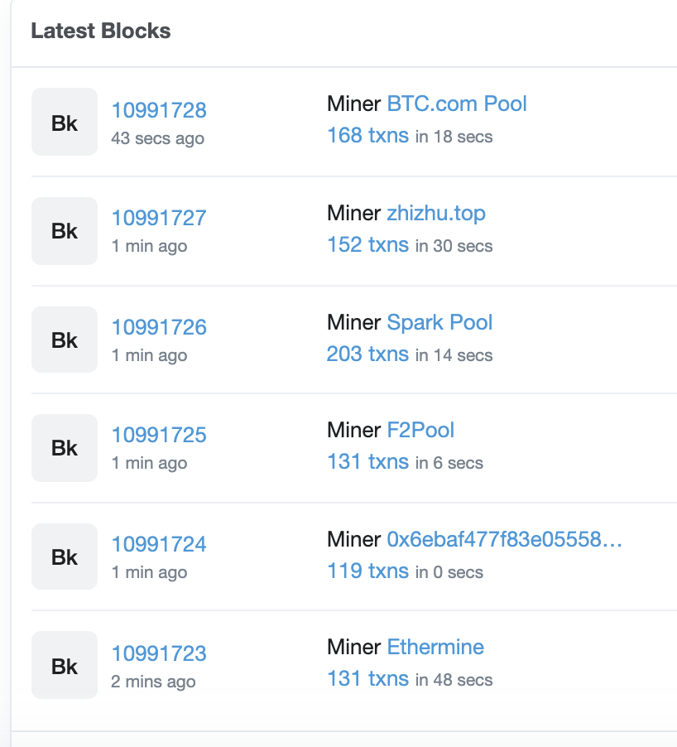
The Ethereum system
Layer 1 (ETHv1): PoW consensus. Block reward = 2 ETH + Tx fees (gas)
avg. block rate = 15 seconds.
ETHv1: variant of Nakamoto PoW
ETHv2: proof of stake consensus
about 150 Tx per block.

Slide 11
Ethereum compute layer: the EVM
World state: set of accounts identified by 32-byte address.
Two types of accounts:
owned accounts: controlled by ECDSA signing key pair (PK,SK).
SK signing key known only to account owner
(2) contracts: controlled by code.
code set at account creation time, does not change

Slide 12
Data associated with an account
Account data Owned Contracts
address (computed): H(PK) H(CreatorAddr, CreatorNonce)
code: ⊥ CodeHash
storage root (state): ⊥ StorageRoot
balance (in Wei): balance balance (10¹⁸ Wei = 1 ETH)
nonce: nonce nonce
(#Tx sent) + (#accounts created): anti-replay mechanism

Slide 13
Account state: persistent storage
Every contract has an associated storage array S[]:
S[0], S[1], … , S[2²⁵⁶-1]: each cell holds 32 bytes, init to 0.
Account storage root: Merkle Patricia Tree hash of S[]
Cannot compute full Merkle tree hash: 2²⁵⁶ leaves
0
0, a
S[000] = a
S[010] = b
S[011] = c
S[110] = d
time to compute root hash:
≤ 2×|S|
0
0
⊥, b
root
1
1
10, d
1
⊥, c
|S| = # non-zero cells
Notes:
Store suffix in nodes.

Slide 14
State transitions: Tx and messages
Transactions: signed data by initiator
To: 32-byte address of target (0 ⇾ create new account)
From, [Signature]: initiator address and signature on Tx (if owned)
Value: # Wei being sent with Tx
Tx fees (EIP 1559): gasLimit, maxFee, maxPriorityFee (later)
if To = 0: create new contract code = (init, body)
if To ≠ 0: data (what function to call & arguments)
nonce: must match current nonce of sender (prevents Tx replay)
Notes:
nonce must match current nonce of sender in sender’s account data. When Tx processed successfully, nonce in sender’s account data is incremented by 1.

Slide 15
State transitions: Tx and messages
Transaction types:
owned ⇾ owned: transfer ETH between users
owned ⇾ contract: call contract with ETH & data

Slide 16
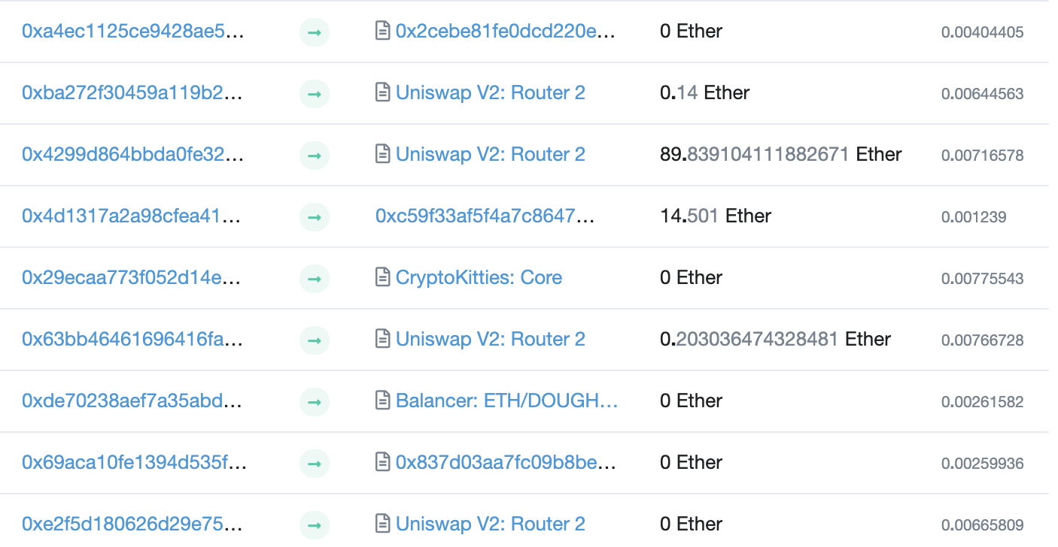
Example (block #10993504)
From
To
msg.value
Tx fee (ETH)
Notes:
Some Tx go to contracts, others go to owned addresses

Slide 17
Messages: virtual Tx initiated by a contract
Same as Tx, but no signature (contract has no signing key)
contract ⇾ owned: contract sends funds to user
contract ⇾ contract: one program calls another (and sends funds)
One Tx from user: can lead to many Tx processed. Composability!
Tx from owned addr ⇾ contract ⇾ another contract
another contract ⇾ different owned

Slide 18
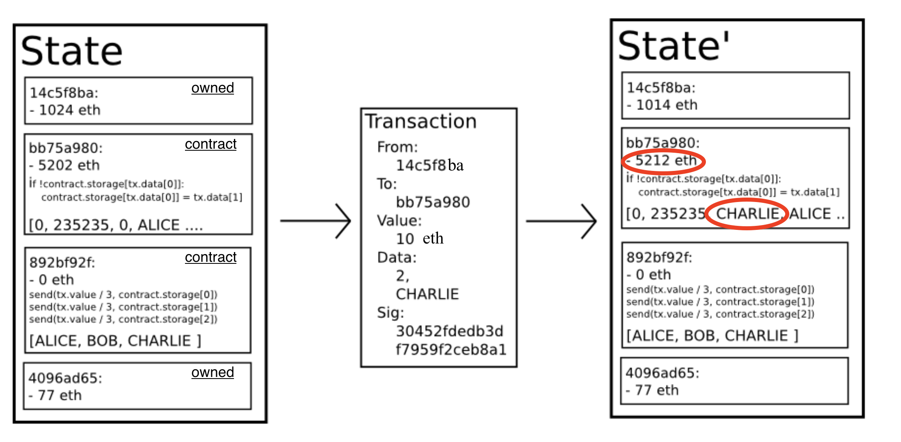
Example Tx
world state (four accounts)
updated world state

Slide 19
An Ethereum Block
Miners collect Txs from users ⇒ leader creates a block of n Tx
Miner does:
for i=1,…,n: execute state change of Tx_{i} sequentially
(can change state of >n accounts)
record updated world state in block
Other miners re-execute all Tx to verify block
Miners should only build on a valid block
Miners are not paid for verifying block (note: verifier’s dilemma)
Notes:
Other blockchains allow for non-interfering parallel execution: Flow, Solana.

Slide 20
Block header data (simplified)
consensus data: parent hash, difficulty, PoW solution, etc.
address of gas beneficiary: where Tx fees will go
world state root: updated world state
Merkle Patricia Tree hash of all accounts in the system
(4) Tx root: Merkle hash of all Tx processed in block
(5) Tx receipt root: Merkle hash of log messages generated in block
(5) Gas used: tells verifier how much work to verify block

Slide 21
The Ethereum blockchain: abstractly
prev hash
prev hash
…
…
accts.
accts.
updated world state
Tx
log messages
updated world state
Tx
log messages

Slide 22
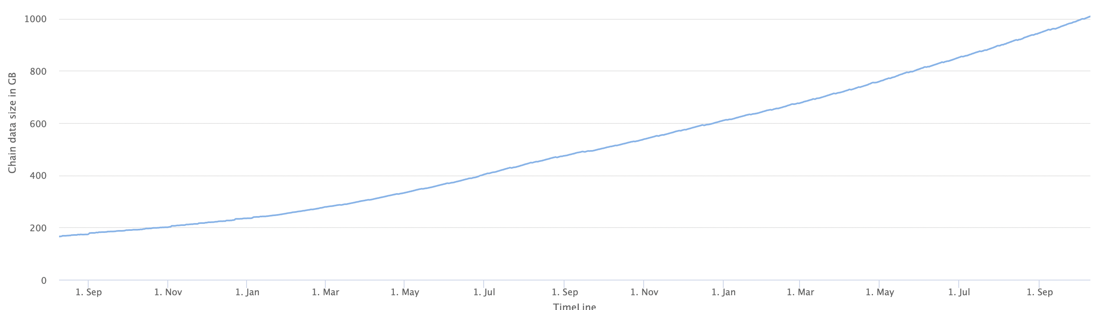
Amount of memory to run a node (in GB)
≈1 TB
ETH total blockchain size: 8.6 TB (Oct. 2021)

Slide 23
An example contract: NameCoin
contract nameCoin { // Solidity code (next lecture)
struct nameEntry {
address owner; // address of domain owner
bytes32 value; // IP address
}
// array of all registered domains
mapping (bytes32 => nameEntry) data;

Slide 24

An example contract: NameCoin
function nameNew(bytes32 name) {
// registration costs is 100 Wei
if (data[name] == 0 && msg.value >= 100) {
data[name].owner = msg.sender // record domain owner
emit Register(msg.sender, name) // log event
}}
Code ensures that no one can take over a registered name
Serious bug in this code!
Front running.
Solved using commitments.

Slide 25
An example contract: NameCoin
function nameUpdate(
bytes32 name, bytes32 newValue, address newOwner) {
// check if message is from domain owner,
// and update cost of 10 Wei is paid
if (data[name].owner == msg.sender && msg.value >= 10) {
data[name].value = newValue; // record new value
data[name].owner = newOwner; // record new owner
}}}

Slide 26
An example contract: NameCoin
function nameLookup(bytes32 name) {
return data[name];
}
} // end of contract

Slide 27
EVM mechanics: execution environment
Write code in Solidity (or another front-end language)
⇒ compile to EVM bytecode
(some projects use WASM or BPF bytecode)
⇒ miners use the EVM to execute contract bytecode in response to a Tx

Slide 28
The EVM
Stack machine (like Bitcoin) but with JUMP
max stack depth = 1024
program aborts if stack size exceeded; miner keeps gas
contract can create or call another contract
In addition: two types of zero initialized memory
Persistent storage (on blockchain): SLOAD, SSTORE (expensive)
Volatile memory (for single Tx): MLOAD, MSTORE (cheap)
LOG0(data): write data to log
see https://ethervm.io/

Slide 29
Every instruction costs gas, examples:
SSTORE addr (32 bytes), value (32 bytes)
zero ⇾ non-zero: 20,000 gas
non-zero ⇾ non-zero: 5,000 gas (for a cold slot)
non-zero ⇾ zero: 15,000 gas refund
Refund is given for reducing size of blockchain state
SELFDESTRUCT addr: kill current contract (in the past: 24,000 gas refund)
CREATE : 32,000 + 200×(code size) gas CALL gas, addr, value, args
Notes:
Selfdestruct addr: sends all account funds to specified address. Refund removed to avoid gastokens.
CREATE: create a new contract
CALL: contract at address addr, with max gas, and value

Slide 30
Gas calculation
Why charge gas?
Tx fees (gas) prevents submitting Tx that runs for many steps.
During high load: miners choose Tx from the mempool that maximize their income.
Old EVM: (prior to EIP1559, live on 8/2021)
Every Tx contains a gasPrice ``bid’’ (gas ⇾ Wei conversion price)
Miners choose Tx with highest gasPrice (max sum(gasPrice×gasLimit))
⟹ not an efficient auction mechanism (first price auction)

Slide 31
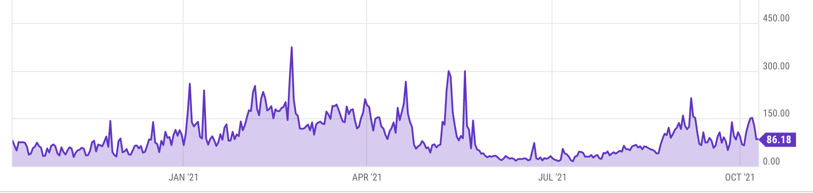
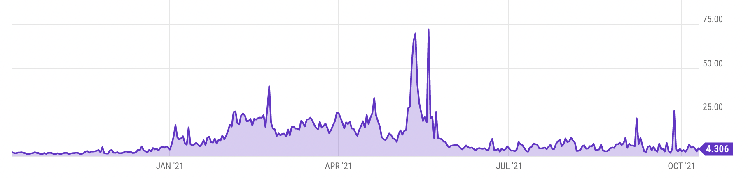
Gas prices spike during congestion
GasPrice in Gwei: 86 Gwei = 86×10⁻⁹ ETH
Average Tx fee in USD
Notes:
https://ycharts.com/indicators/ethereum_average_gas_price
https://ycharts.com/indicators/ethereum_average_transaction_fee

Slide 32
Gas calculation: EIP1559
Every block has a “baseFee”:
the minimum gasPrice for all Tx in the block
baseFee is computed from total gas in earlier blocks:
earlier blocks at gas limit (30M gas) ⟹ base fee goes up 12.5%
earlier blocks empty ⟹ base fee decreases by 12.5%
If earlier blocks at “target size” (15M gas) ⟹ base fee does not change
interpolate
in between

Slide 33
Gas calculation
EIP1559 Tx specifies three parameters:
gasLimit: max total gas allowed for Tx
maxFee: maximum allowed gas price (max gas ⇾ Wei conversion)
maxPriorityFee: additional “tip” to be paid to miner
Computed gasPrice bid:
gasPrice ⇽ min(maxFee, baseFee + maxPriorityFee)
Max Tx fee: gasLimit × gasPrice
Notes:
gas for each instruction defined by a hard coded table.

Slide 34

Gas calculation
if gasPrice < baseFee: abort
If gasLimit×gasPrice < msg.sender.balance: abort
deduct gasLimit×gasPrice from msg.sender.balance
set Gas ⇽ gasLimit
execute Tx: deduct gas from Gas for each instruction
if at end (Gas < 0): abort, Tx is invalid (miner keeps gasLimit×gasPrice)
(6) Refund Gas×gasPrice to msg.sender.balance
(7) gasUsed ⇽ gasLimit – Gas
(7a) BURN gasUsed× baseFee
(7b) Send gasUsed×(gasPrice – baseFee) to miner
Notes:
gas for each instruction defined by a hard coded table.
BURN: deflates the currency

Slide 35
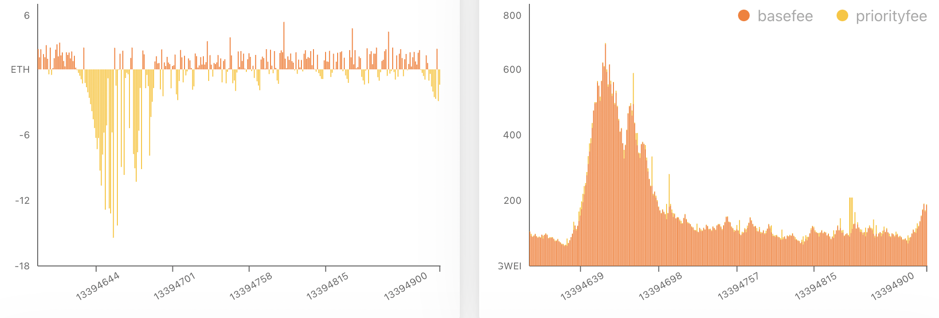
Burn results in practice
block reward (2ETH) – Total baseFee burned in block
baseFee for block (Wei)
high baseFee period
high burn
… sometimes burn exceeds block rewards ⟹ ETH deflation
watchtheburn.com

Slide 36
Why burn ETH ???
EIP1559 goals (informal):
users incentivized to bid their true utility for posting Tx,
miners incentivized to not create fake Tx, and
disincentivize off chain agreements.
Suppose no burn (i.e., baseFee given to miners):
⟹ in periods of low Tx volume miners would try to increase volume by offering to refund the baseFee off chain to users.
Notes:
If a second price auction were used: miners would be incentivized to create fake transactions.
See https://arxiv.org/pdf/2106.01340.pdf for an analysis.

Slide 37
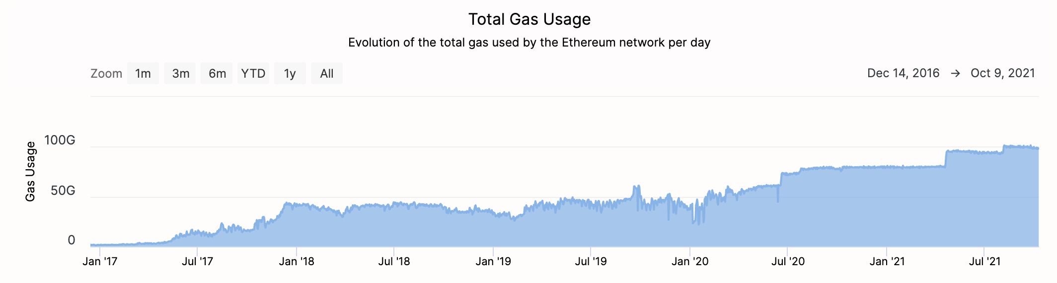
Note: transactions are becoming more complex
Gas usage is increasing ⇒ each Tx takes more instructions to execute
Notes:
https://etherchain.org/charts/totalGasUsage

Slide 38
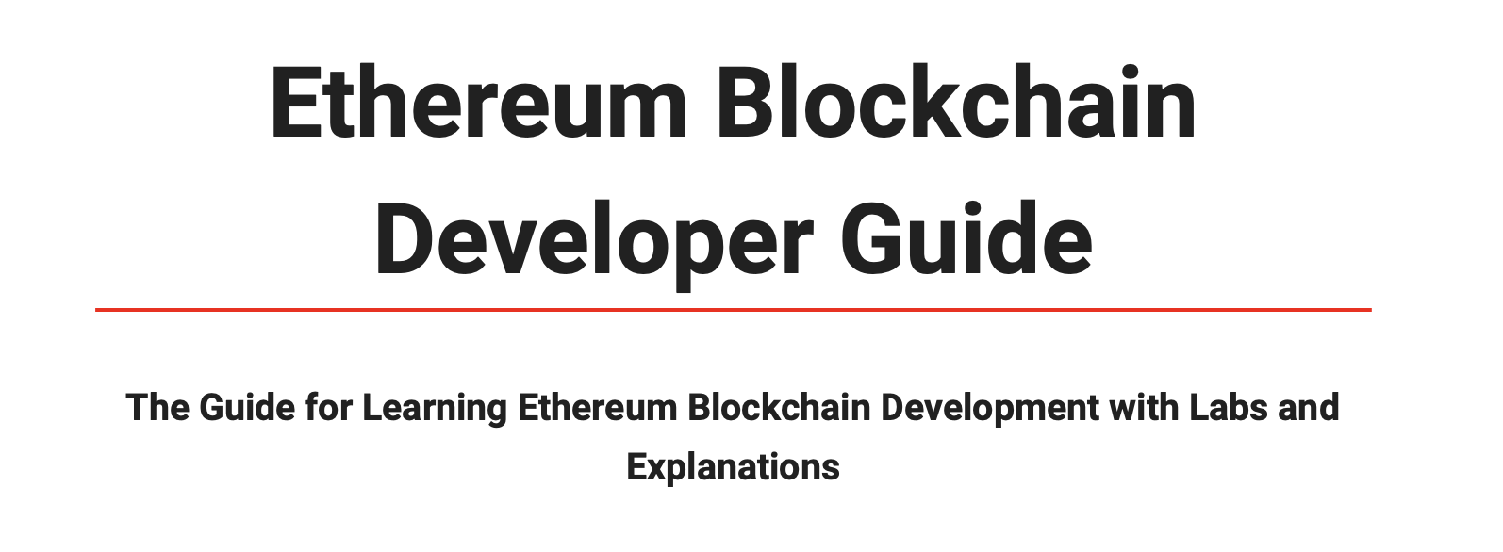
Home Work
Ethereum Tutorial – Hands on Lab
Deliverables UTS: Video Screencast/PPTX and Git

Slide 39
END OF LECTURE
Next: Writing Solidity Contract

